Slide 1
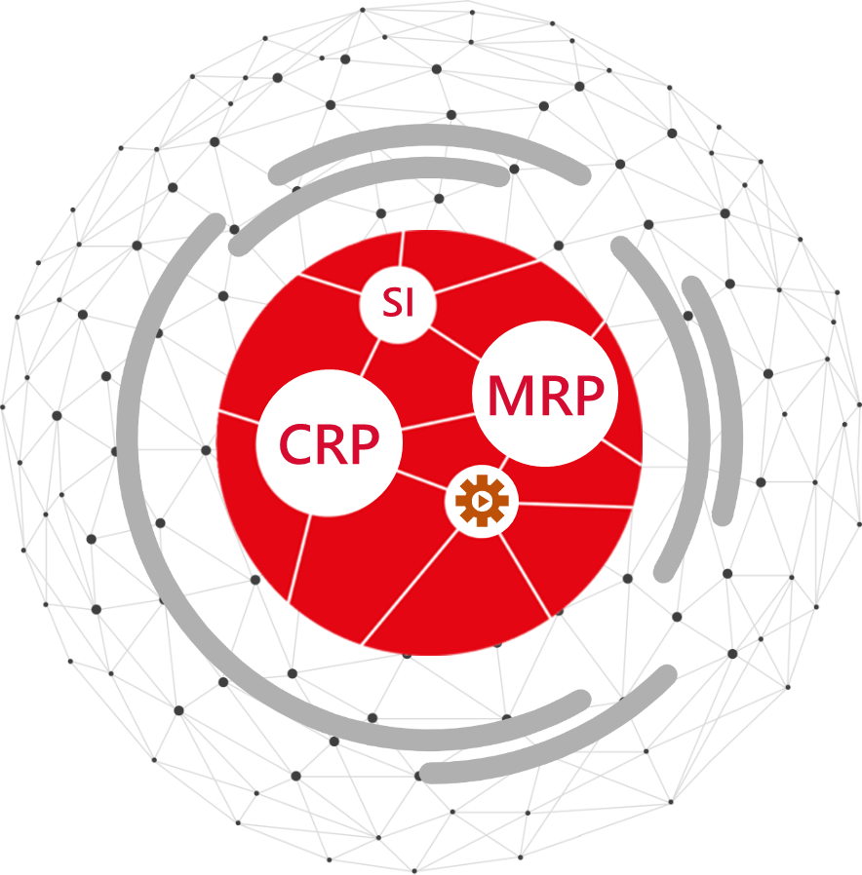

Attendance Management System
System Design Sheet Approval

Slide 2

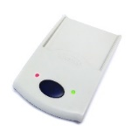




Tap In
Tap Out
DTR Logs
Overtime
PRODUCTION STAFF
AGENCY
9 AM Daily
DTR Form
Overtime Form
Change Schedule
Employee List
LINE LEADER
AMS
3 AM (Synchronize)
I.T. SYSTEM
M_Employee_Master_List
M_Cost_Center_List
M_Employee_Category
SECTION
APPROVER
Cost Center Change
Overtime
Approved/Disapprove Request
12 AM
(Synchronize)
9 AM – 3 PM Daily
HR
MANAGER
PCORE
Approved/Disapprove Request
Receive Email from AMS
Overall System Image

Slide 3

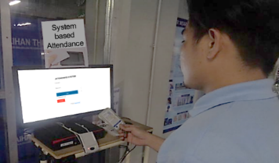




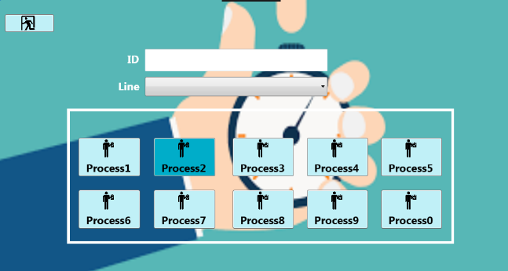
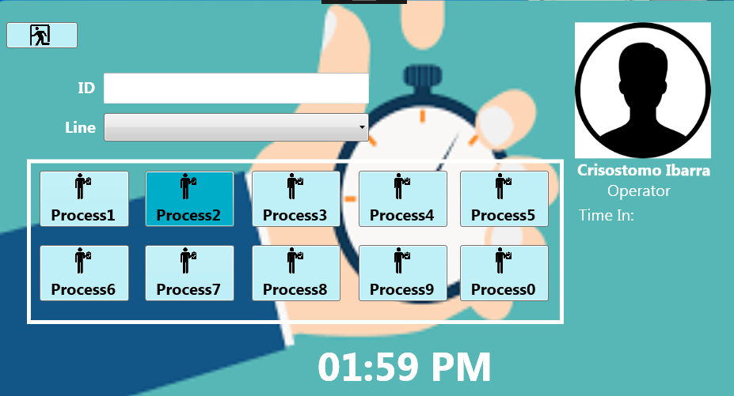
Tap IN/OUT
Local Database
(SQL Lite)
Send Local DB data to Server by CSV File
Note: Send interval can be adjusted
Tap IN/OUT
I.T. SYSTEM
Local Database
(SQL Lite)
LAST PERSON IN
SELECT PROCESS
SELECT LINE
Tap In/Out Process

Slide 4
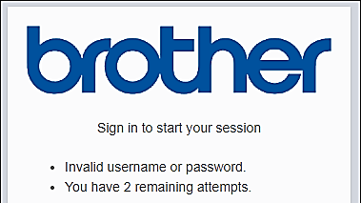
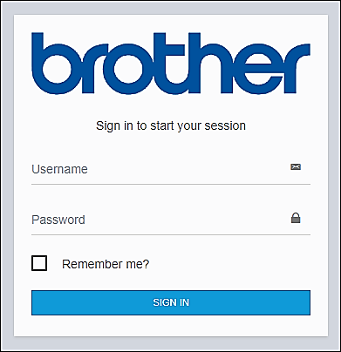
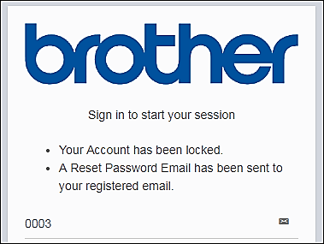
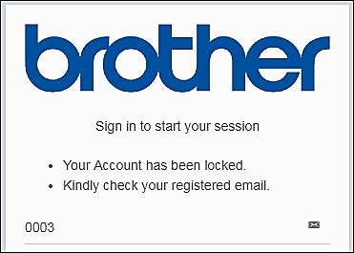
Details:
Login Username: Employee ADID
Login Password
First password will be sent to registered email in User Master
Incase of wrong login credentials, User will be given 5 attempts before the User Account is locked. Reset password will be sent through registered email.
Login Screen

Slide 5
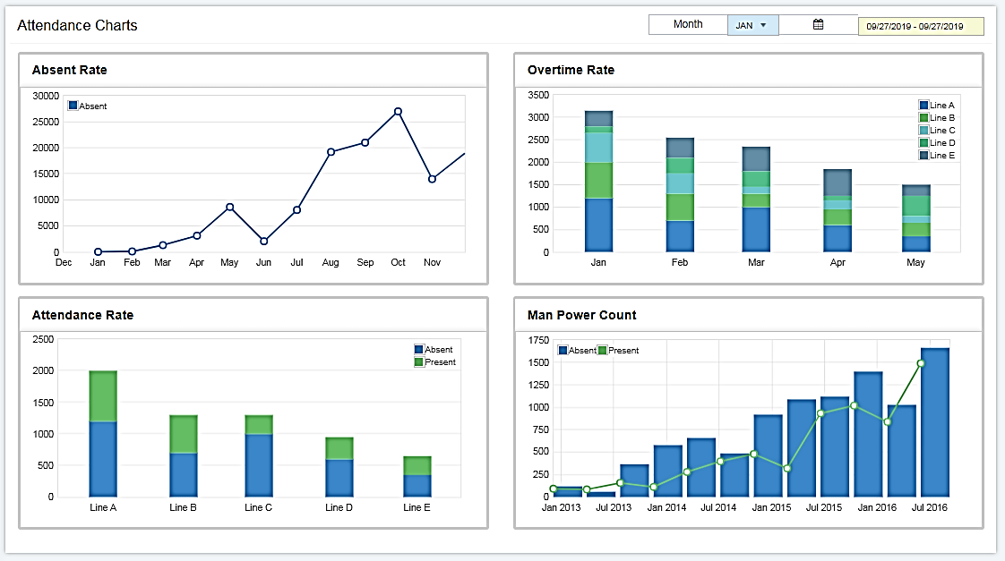
Details:
Charts can be viewed per Day, per Month or specific Date span (applies to all Charts available)
Absent Rate Chart will also show the type of Absence or Leave (VL, SL or AWOL)
Dashboard/Home Screen

Slide 6
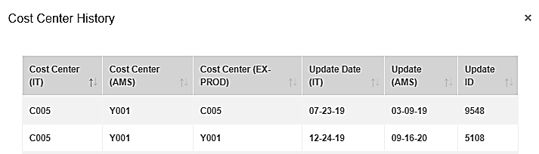
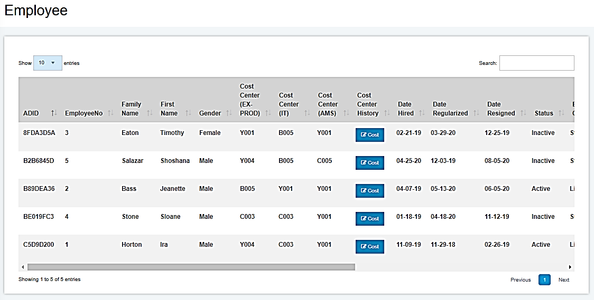


Details:
Data will automatically be copied from IT System (BIPH) to AMS System every 3 AM.
Any changes such as additional Employees or Change in Employee information will be summarized and sent to Administrators through Email in Excel format file
Only Cost Center for AMS and EX-PROD can be modified using the AMS System
Employee Master Columns:
ADID
Employee No
Family Name
First Name
Gender
Date Hired
Date Regularized
Date Resigned
Employee Status
Employee Category
Section
Position
Email Address
RFID
Cost Center (IT)
Cost Center (AMS)
Cost Center (EX-PROD)
Cost Center History Columns:
Cost Center (IT)
Cost Center (AMS)
Cost Center (EX-PROD)
Update Date (IT)
Update Date (AMS)
Update ID
Employee List
AMS
AGENCY
3 AM (Synchronize)
I.T. SYSTEM
M_Employee_Master_List
M_Cost_Center_List
M_Employee_Category
12 AM
(Synchronize)
M_Employee_Master_List
M_Cost_Center_List
M_Employee_Category
PCORE
Employee Master

Slide 7
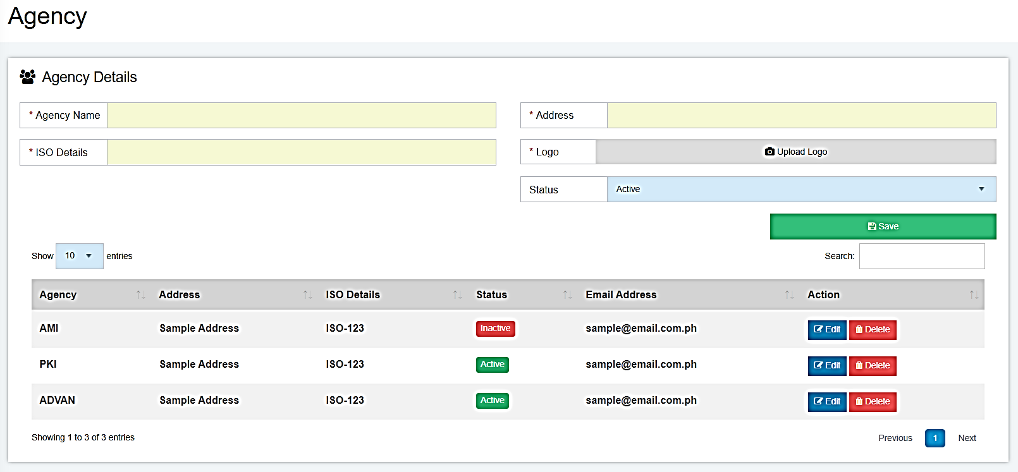
Details:
Agency Master will include the following details:
Agency Name
Address
ISO Details
Logo
The Agency details will be used for the following Standardized Forms:
Overtime Form
Change Schedule Form
DTR Correction Form
Start
Modify Agency Name
Modify Address
Modify ISO Details
Select Status
Yes
Save Agency Details
Existing
Click Save button
Input Agency Name
End
No
Input Address
Input ISO Details
Select Status
Agency Master

Slide 8
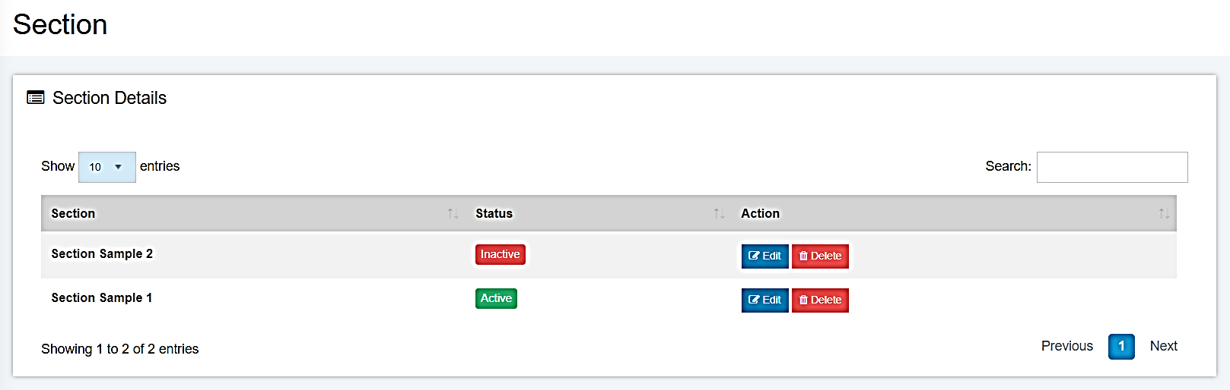
Details:
Data will automatically be copied from IT System (BIPH) to AMS System every 3 AM.
Any changes such as additional Section or Change in Section information will be summarized and sent to Administrators through Email in Excel format file
Section Master Columns:
Section (Section Name)
AMS
12 AM
(Synchronize)
3 AM (Synchronize)
PCORE
Section Master
I.T. SYSTEM
Section Master
Section Master

Slide 9
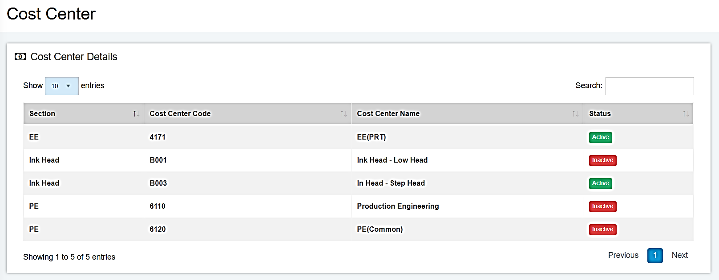
Details:
Data will automatically be copied from IT System (BIPH) to AMS System every 3 AM.
Any changes such as additional Cost Center or Change in Cost Center information will be summarized and sent to Administrators through Email in Excel format file
Section Master Columns:
Section (Section Name)
Cost Center Code
Cost Center Name
AMS
12 AM
(Synchronize)
3 AM (Synchronize)
PCORE
Cost Center Master
I.T. SYSTEM
Cost Center Master
Cost Center Master

Slide 10
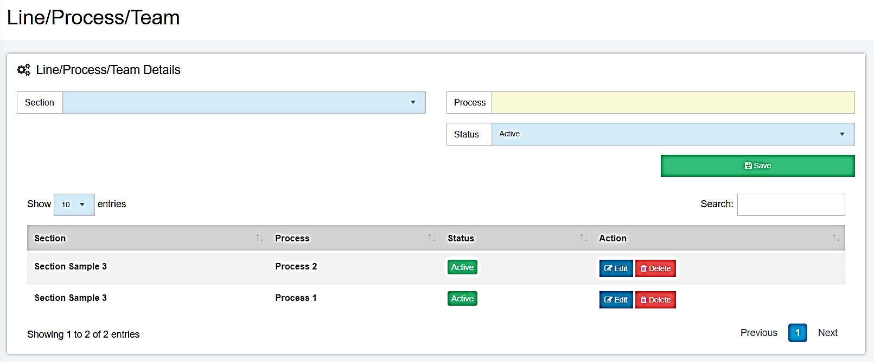
Details:
Line/Process/Team Master will include the following details:
Section
Process
Start
Select Section
Modify Process name
Select Status
Yes
Save Line/Process/Team Details
Existing
Click Save button
Select Section
Select Status
End
No
Input Process Name
Line/Process/Team Master

Slide 11
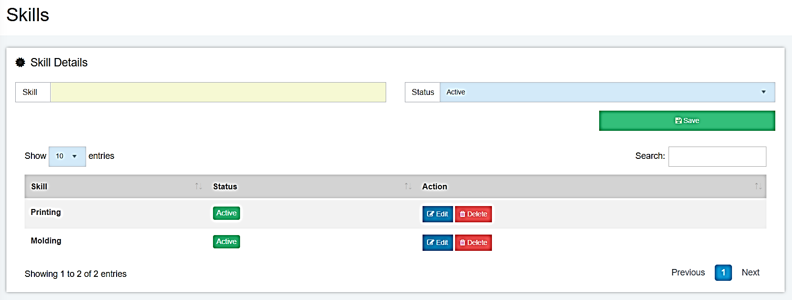
Details:
Skills Master will include the following details:
Skill (Skill Name)
Start
Modify Skill name
Select Status
Yes
Save Line/Process/Team Details
Existing
Click Save button
Select Status
End
No
Input Skill Name
Skills Master

Slide 12
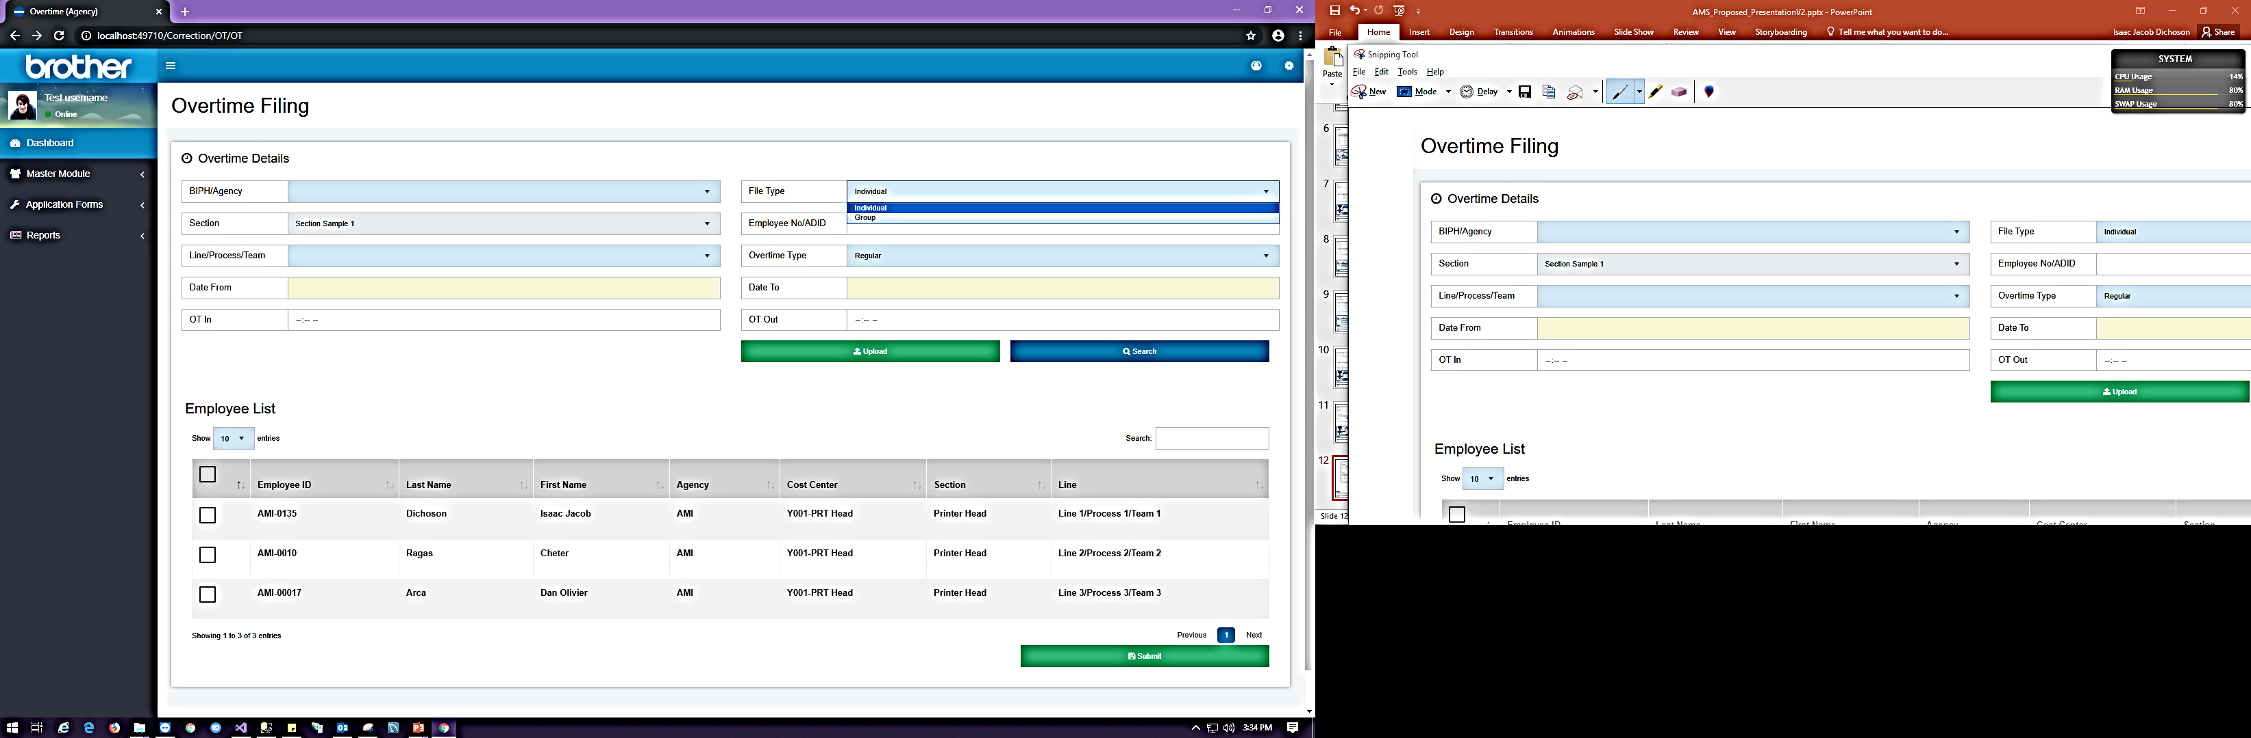
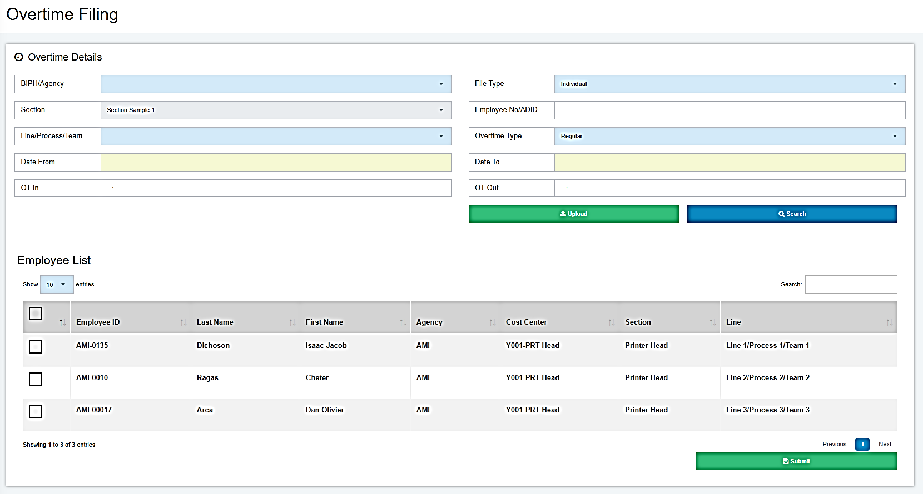
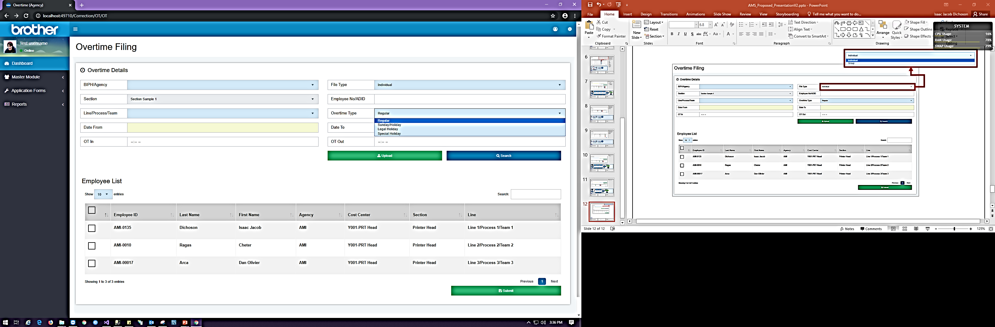
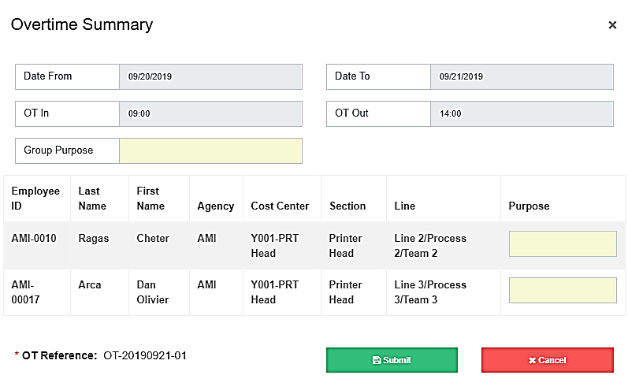
Sunday and Regular Holiday Overtime will require approval from General Manager
A list of all employees applied for Overtime sill appear after clicking Summarize Button
System and Email notification will be sent respective approved once the Overtime is submitted
Overtime Filing

Slide 13
Start
Select Checker
Select File Type
Select Checker Name
Group
Yes
No
BIPH
Select Employee No
Yes
Select Approver
No
Select Date From
Select Date From
Select Date To
Select Date To
Yes
Select Approver Name
Select Shift
OT In
With Change
No
Submit Button
Purpose
OT Out
OT Type
OT Type
Save
User Data
Assign current user as “Prepared By”
End
Overtime Filing Process

Slide 14
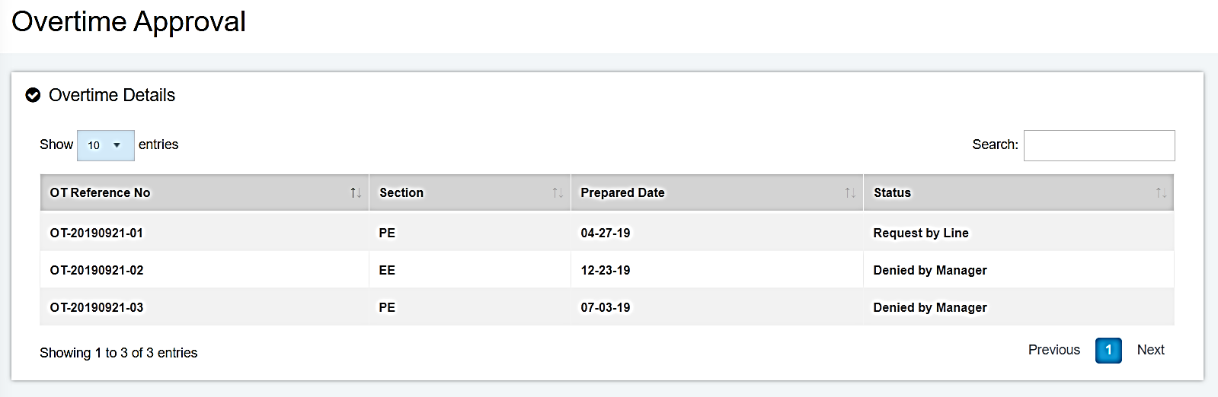
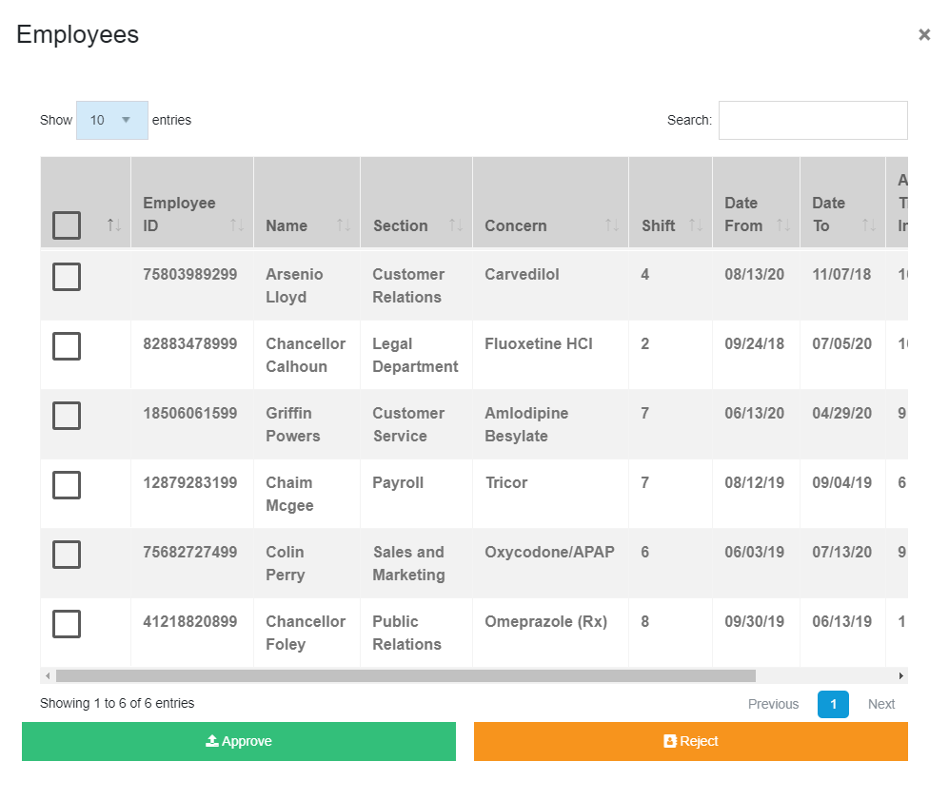
A list of all employees applied for Overtime will appear after double clicking a row
Overtime Approval

Slide 15
Start
Select Checker
Select File Type
Select Checker Name
Group
Yes
No
BIPH
Select Employee No
Yes
Select Approver
No
Select Date From
Select Date From
Select Date To
Select Date To
Yes
Select Approver Name
Select Shift
OT In
With Change
No
Submit Button
Purpose
OT Out
OT Type
OT Type
Save
User Data
Assign current user as “Prepared By”
End
Overtime Approval Process

Slide 16
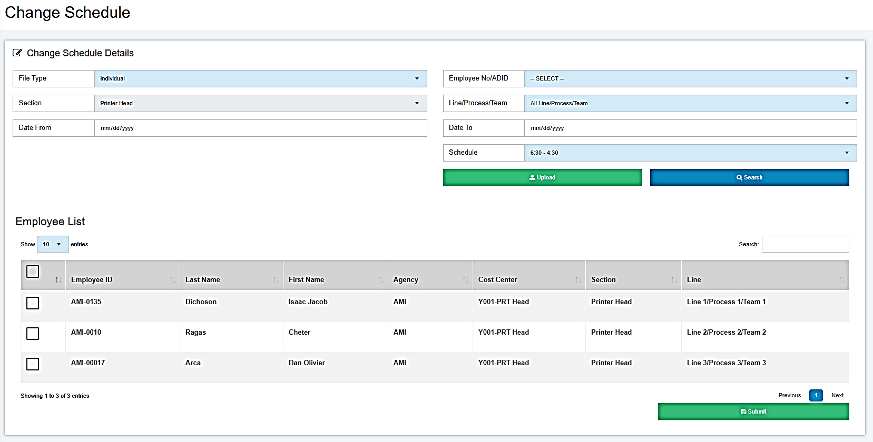
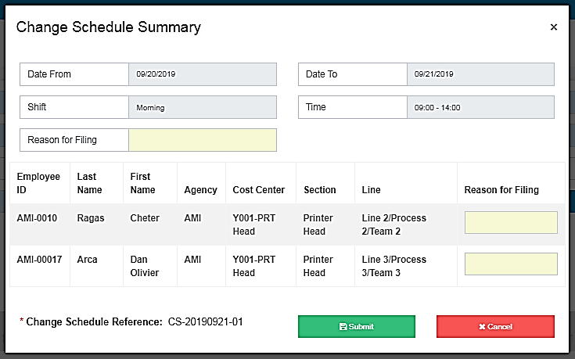
A list of all employees applied for Change Schedule will appear after double clicking a row
Change Schedule

Slide 17
Start
Select Checker
Select File Type
Select Checker Name
Group
Yes
No
BIPH
Select Employee No
Yes
Select Approver
No
Select Date From
Select Date From
Select Date To
Select Date To
Yes
Select Approver Name
Shift
Shift
With Change
No
Submit Button
Reason for filing
Reason for filing
Save
User Data
Assign current user as “Prepared By”
End
Change Schedule Process

Slide 18
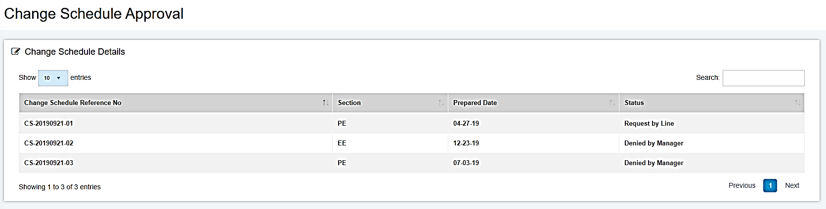
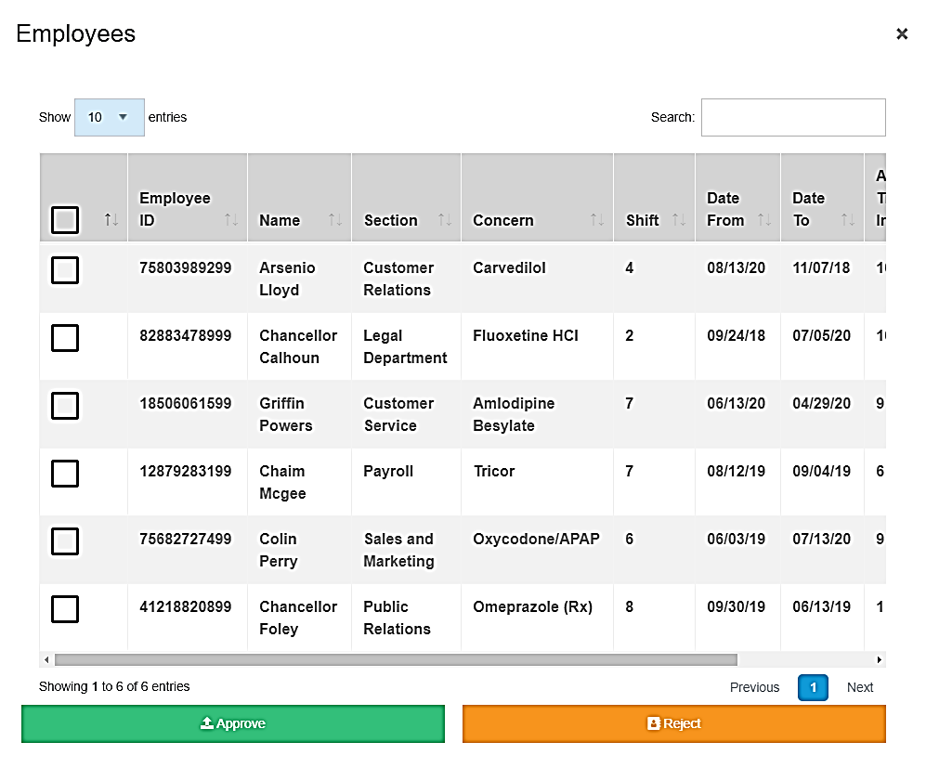
A list of all employees applied for Change Schedule will appear after double clicking a row
Change Schedule Approval

Slide 19
Start
Select Checker
Select File Type
Select Checker Name
Group
Yes
No
BIPH
Select Employee No
Yes
Select Approver
No
Select Date From
Select Date From
Select Date To
Select Date To
Yes
Select Approver Name
Shift
Shift
With Change
No
Submit Button
Reason for filing
Reason for filing
Save
User Data
Assign current user as “Prepared By”
End
Change Schedule Approval Process

Slide 20
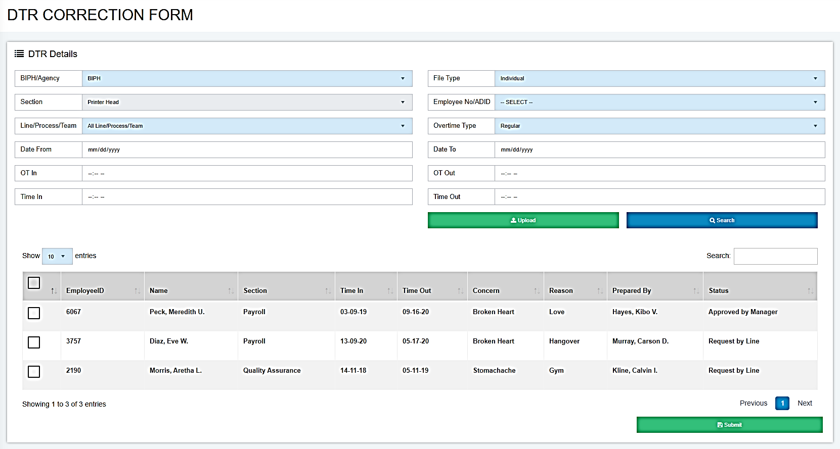
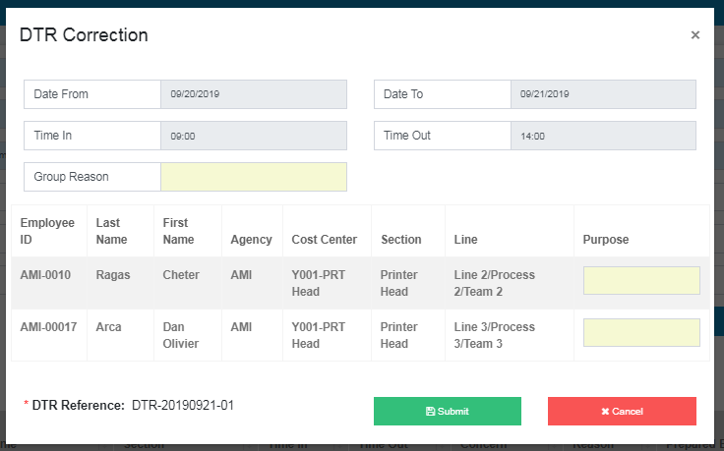
A list of all employees applied for DTR Correction will appear after double clicking a row
DTR Form

Slide 21
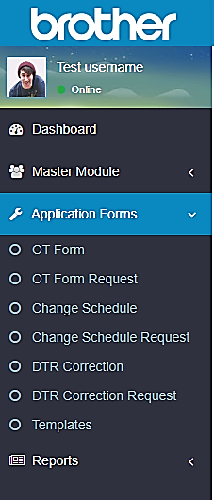
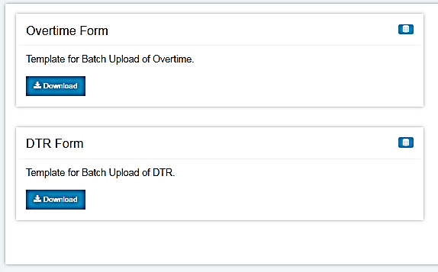
All templates for filing OT, Change Schedule and DTR can be downloaded in system

